Slide 1
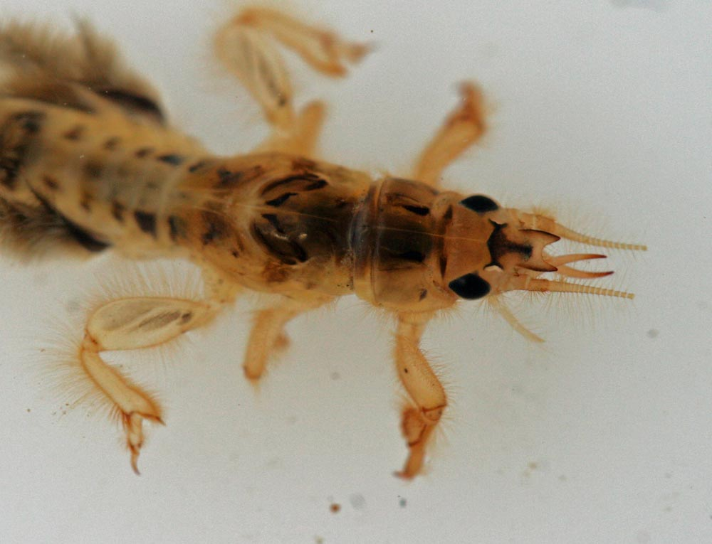
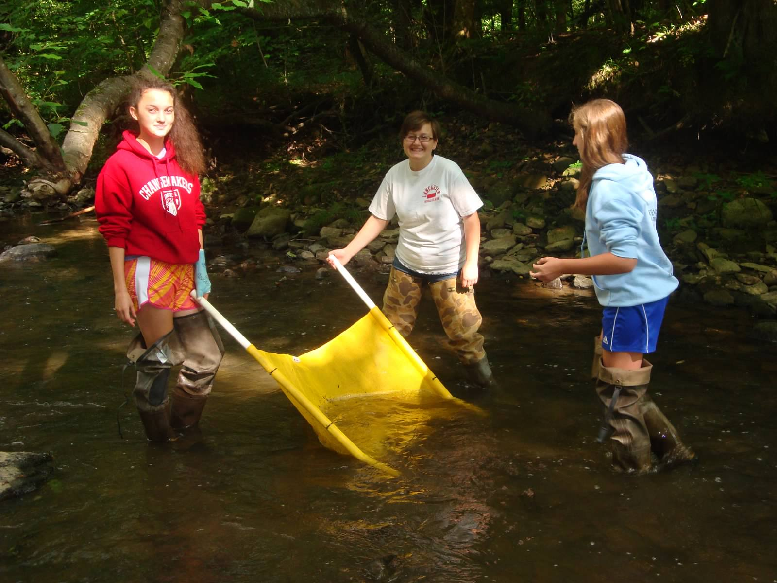
Aquatic Macroinvertebrates
A Presentation Created by Creek Connections
Notes:
When people think about aquatic life, they think about frogs, fish, crayfish, and lily pads. Many people don't think about aquatic insects. There are thousands of species.

Slide 2
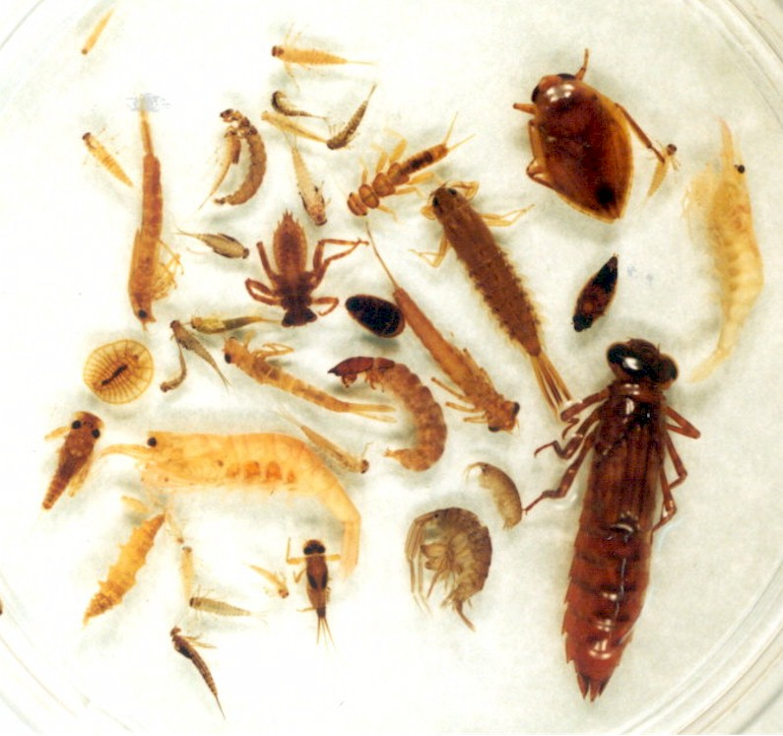
Aquatic Macroinvertebrates
7% of the 91,000+ insects in North America are aquatic or semi-aquatic
They are found in every type of waterway
Notes:
Of the 91,000+ North American insects, 7% are aquatic or semi-aquatic. They can be found in every type of waterway, from a small temporary pond to a forested creek to a large river passing through a city.

Slide 3
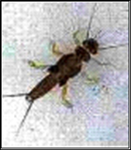
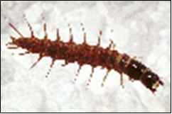
Aquatic Macroinvertebrates
What is a macroinvertebrate?
Includes:
Arthropods
-Insects in all life cycles
-Crustaceans
-Arachnids
Mollusks
Worms
Lack internal skeletons
Visible by unaided eye
http://www.thomasames.com/insects/other/
http://www.thomasames.com/insects/other/
Notes:
You will hear the term aquatic macroinvertebrate used often. What does this term mean? Macroinvertebrates are organisms without internal skeletons that can be seen with the unaided eye (often considered larger than 0.5 mm).
The term aquatic macroinvertebrate can include arthropods – aquatic insects in all life cycle stages (nymphs, larva, pupa, or adults) and arthropods include crustaceans and aquatic arachnids. Mollusks and worms are also sometimes considered together with aquatic macroinvertebrates.

Slide 4
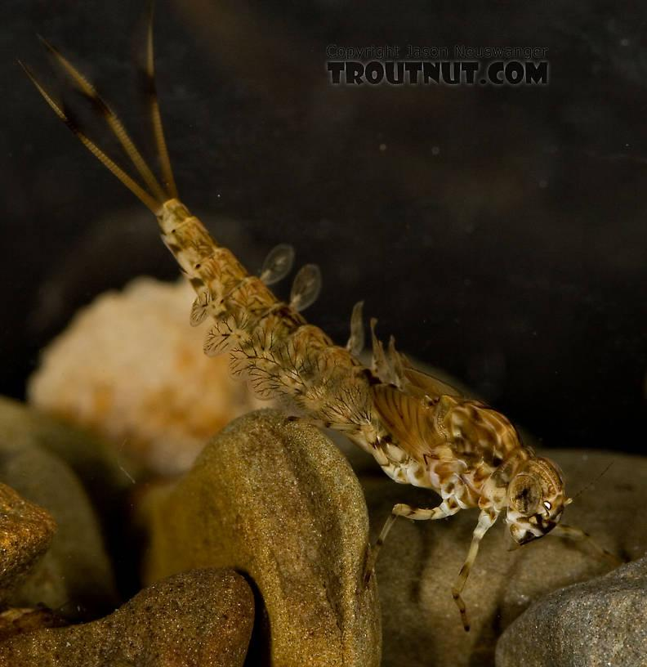
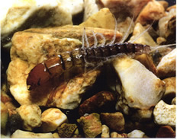
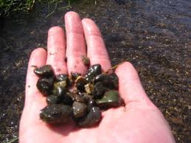
Benthic Macroinvertebrates
What is Benthic?
Bottom-dwelling
Mayfly nymph Alderfly larva
Substrate
Notes:
Sometimes aquatic macroinvertebrates are said to be benthic, which means bottom-dwelling. Many aquatic insects live, move along, and attach themselves to the waterway bottom. The waterway bottom is called the substrate.

Slide 5
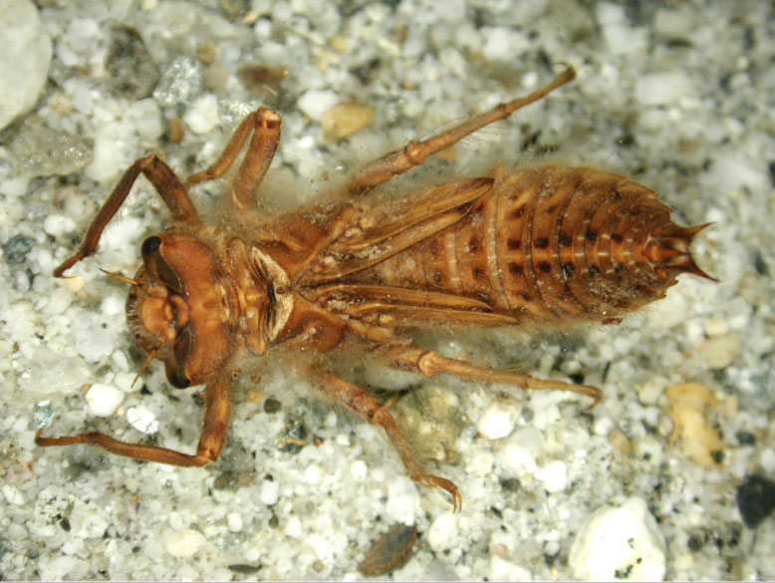
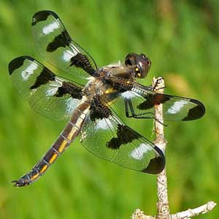
Aquatic Insects Life Cycles
Many insects start their lives in water
Juvenile Adult
Dragonfly
Metamorphosis
Notes:
The majority of aquatic macroinvertebrates that inhibit waterways are simply the juvenile form of an adult, land-dwelling insect. Many aquatic insects start off life underwater. Because their immature aquatic bodies are specially suited for life underwater, they often do not resemble their land-dwelling, adult body form. Before the juvenile aquatic insect can leave its original aquatic home, it must undergo several physical changes to prepare itself for life on land. This change in physical appearance is called metamorphosis.

Slide 6
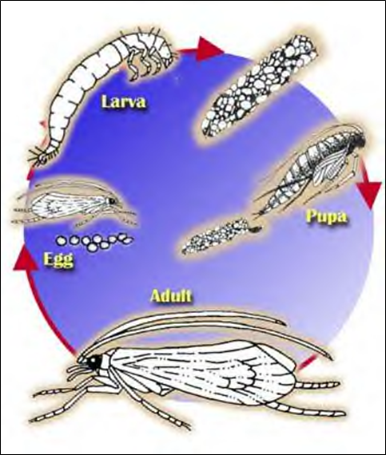
Aquatic Insects
Complete
Metamorphosis
-Egg
-Larva
-Pupa
-Adult
http://www.kidfish.bc.ca/caddisfly.htm
Notes:
The extent of change that the aquatic organism undergoes varies from organism to organism. There are two types of metamorphosis: complete metamorphosis and incomplete metamorphosis. Almost 90% of the insects that undergo metamorphosis undergo complete metamorphosis. Complete metamorphosis consists of four stages. The organism begins as an egg, then is hatched a larva, (often resembles little of mature adult), which gradually matures into a pupa, which then wraps itself into a cocoon, where it finally transforms into the adult land-dwelling insect.

Slide 7
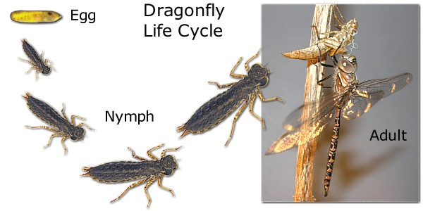
Aquatic Insects
Incomplete
Metamorphosis
-Eggs
-Nymph
-Adult
Explore More:
-http://www.kidfish.bc.ca/insects.htm
-Do the “Aquatic Insect Life Cycle” Activity from module
http://www.naturenorth.com/dragonfly/DOM/Page02_Life_Cycle.html
Notes:
Incomplete metamorphosis has only three main stages of development. The insect again begins as an egg, which is hatched and becomes a nymph. Nymphs are a miniature version of the adult form. They are sexually immature, and grow larger through a series of molts until they reach full size and develop wings. This is the adult stage.

Slide 8
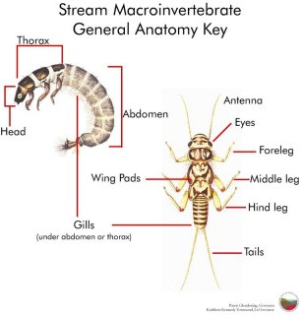
Aquatic Insect Anatomy
http://www.dnr.state.md.us/education/envirothon/aquatic_insect_ecology.html
Notes:
There are three main, distinct body regions that are common amongst aquatic insects. They are the head, thorax, and abdomen.
Many aquatic insects, but not all, have a tail attached to the abdomen.

Slide 9
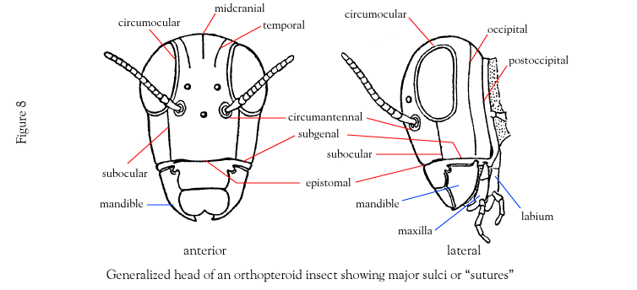
Aquatic Insect Anatomy
Head
http://www.life.umd.edu/entm/shultzlab/snodgrass/Lecture1/indexq.htm
Notes:
The first region, the head, is usually capsule-like and contains the sensory organs, differing mouthparts, and often compound eyes. Antennae and mouthparts are sometimes used as identification characteristics for aquatic bugs.

Slide 10
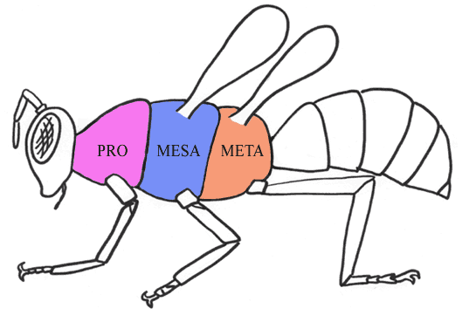
Aquatic Insect Anatomy
Thorax
http://ntugre.blogspot.com/2010_07_01_archive.html
Notes:
The second region is the thorax, often subdivided into the prothorax, mesothorax, and metathorax. An insect’s legs (3 pair) will be found on the thorax. Sometimes wing pads can be seen, showing where the adult’s wings will one day develop.

Slide 11
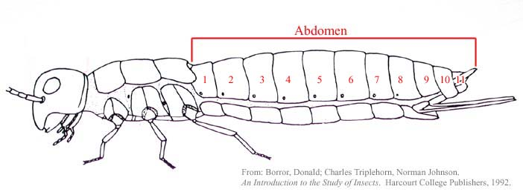
Aquatic Insect Anatomy
Abdomen
Explore more:
-http://www.dddi.org/enttutorial/insect_anatomy/insectanatomy.html
-Do the “Aquatic Insect Parts and Pieces” Activity from module.
http://www.sccs.swarthmore.edu/users/03/cweiss/bugs/glossary.html
Notes:
The abdomen is usually the longest body region composed of several segments. Sometimes the number of segments is an identification characteristic. There might be some appendages attached to the abdomen, but they are not legs. They can be prolegs (fake legs), filaments, gills, breathing tubes, hairs, and bristles – all serving specific functions for the insect. A variety of tails sometimes called cerci can extend from the abdomen. All these appendages and tails can also be identification characteristics.

Slide 12
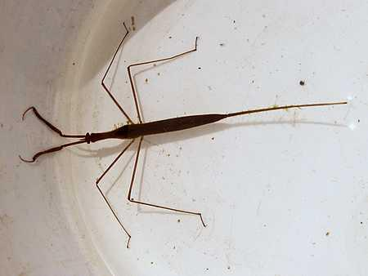
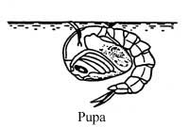
Aquatic Insect Anatomy
Aeropneustic- "Air breathing"
-Snorkel Approach
Respiratory Horns
Water Scorpion
Mosquito Pupa
http://entnemdept.ufl.edu/fasulo/vector/chapter_03.htm
Notes:
Some of the structures on the abdomen help aquatic insects breathe. There are a variety of ways that aquatic insects are able to breathe underwater. Insects can be classified into two breathing categories. The first are aeropneustic insects, “air breathing”, that find a way to get oxygen from the atmosphere even though they live in the water. They may be surface air breathers. A mosquito pupa and water scorpion uses a “snorkel” approach remaining just below the surface and sticking a breathing tube above.

Slide 13
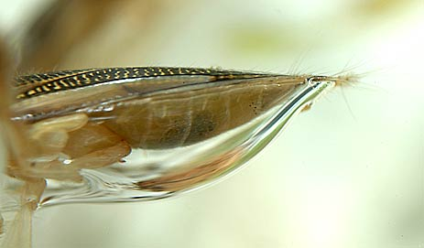
Aquatic Insect Breathing
Aeropneustic- "air breathing"
-Scuba Approach
-Able to survive in low dissolved oxygen settings
-Low oxygen can be a sign of pollution
http://www.microcosmos.nl/bugs2/lbbouwabd.htm
Notes:
A predaceous diving beetle and most other beetles use a “scuba” approach. While underwater, they carry an oxygen rich air bubble on the underside of their body.
Another minor group of insects can pierce into the stems of aquatic plants to obtain oxygen inside. As a result of all of these insects being air breathing, aeropneustic insects are often able to survive in low dissolved oxygen conditions in the waterway, sometime indicative of pollution.

Slide 14
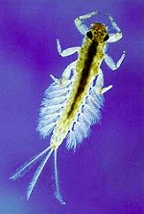
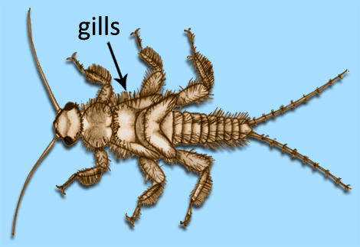
Aquatic Insect Breathing
Hydroneustic-"Water Breathing"
-Breathing through Gills
-Need sufficient DO levels to survive
http://whatcom.wsu.edu/4-h/nrs/waterbugs/ex.html
http://www.cals.ncsu.edu/course/ent425/tutorial/aquatic.html
Notes:
The other breathing category is a hydroneustic insect, meaning “water breathing.” These insects need to use dissolved oxygen from the water and are more affected by pollution impacts that deplete oxygen levels. These insects either intake dissolved oxygen directly through the body surface (like a midge larva or aquatic worm) or by using gills (like a mayfly nymph, stonefly nymph, or dobsonfly larva).

Slide 15
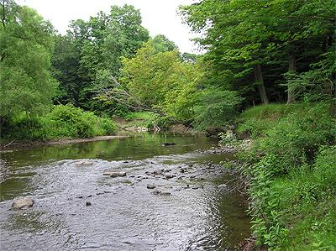
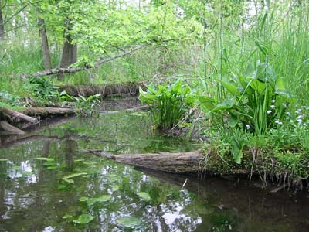
Where Aquatic Insects Live
FACTORS to consider:
Necessary habitat
Food availability
Appropriate water conditions
Size of the waterway
http://www.waterlandlife.org/e-newsletters/may_12/french_creek.html
http://www.epa.gov/greatlakes/aoc/kalamazoo.html
Notes:
As mentioned earlier, aquatic insects live in just about any type of waterway. There are a number of factors that determine where an insect can live or if it would survive there. 1) Necessary habitat. 2) Food availability. 3) Appropriate water conditions including oxygen content, temperature levels, and whether pollution is present. 4) Another factor, the size of the waterway (small creek or big river) influences the above mentioned three. We will be talking about them all and see how they are interconnected

Slide 16
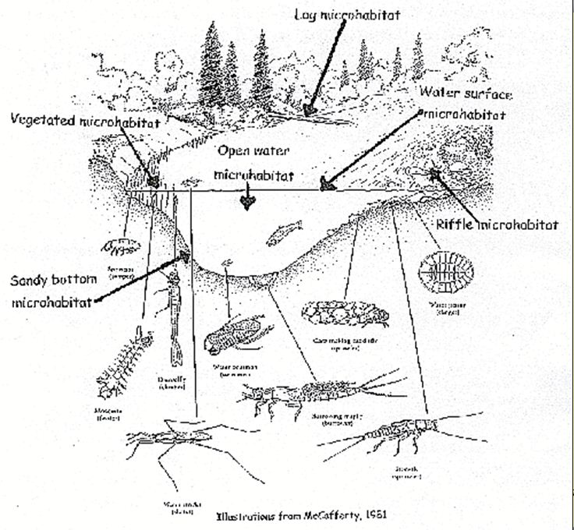
Where Aquatic Insects Live
Habitat
-Place where organism lives that fulfills its need for food, water, shelter, temperature, reproduction, and space
Microhabitat
Explore More:
-Review "Microhabitat"
activities from module
Illustration Source: Aquatic Entomology by W. Patrick McCafferty, 1998
Notes:
Habitat is a place where an organism lives that fulfills its need for food, water, shelter, temperature, reproduction, and space. Within a stream habitat, most aquatic organisms use only a small portion of this larger habitat. This small, specific area is called a microhabitat.

Slide 17
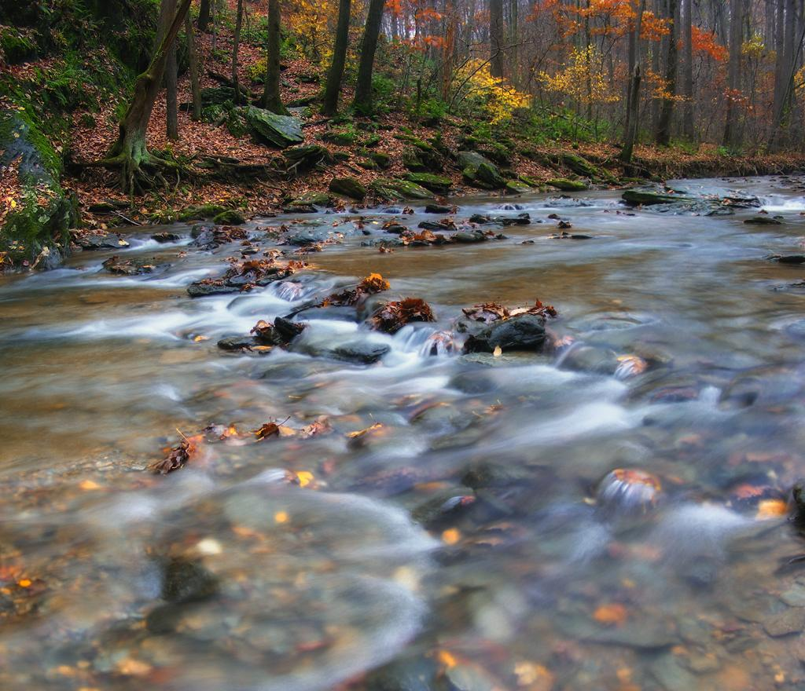
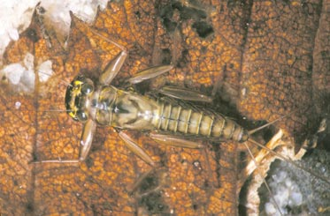
Where Aquatic Insects Live
Microhabitat- Riffle
Explore More:
Review the "Aquatic Macro Sampling" Activity from module
http://www.learnnc.org/lp/editions/mudcreek/6395
Illustration Source: Aquatic Entomology by W. Patrick McCafferty, 1998
Notes:
The largest variety of aquatic insects can be found in riffles, where the stream tumbles over rock and is fast moving. There is more dissolved oxygen there and there are numerous rocks to live on and under. If you pick up any rock in a healthy stream, you can find insects like mayfly nymphs and water pennies clinging to it or living under it in the smaller gravel and sand. Some insects like black fly larvae attach themselves to the top of rocks. A rock is an example of an aquatic microhabitat.

Slide 18
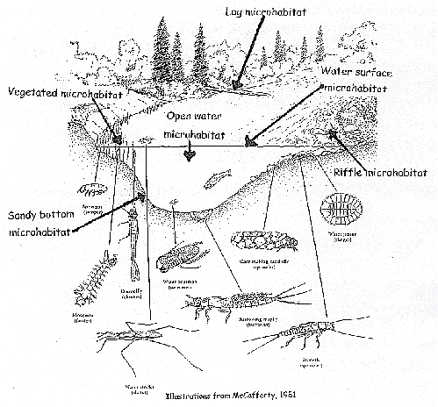
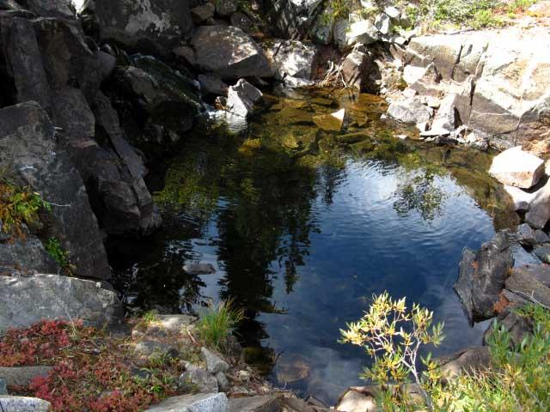
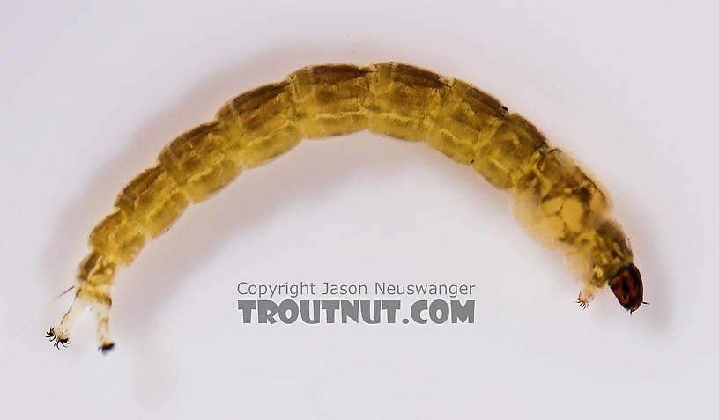
Where Aquatic Insects Live
Microhabitat- Pool
http://tahoetowhitney.com/Sonora%20Pass%20to%20Tuolumne/kennedy-canyon-to-dorothy-lake-pass.html
Illustration Source: Aquatic Entomology by W. Patrick McCafferty, 1998
Midge larva
http://www.troutnut.com/specimen/455
Notes:
Some aquatic insects prefer the slower, deeper stretches of a waterway, called pools. In these spots in the creek, fine sediments have a chance to settle out onto the bottom, creating a muddy, silty, or sandy bottom. Some organisms can burrow down into this substrate, such as a midge larva, burrowing mayfly nymph, and aquatic worm.

Slide 19
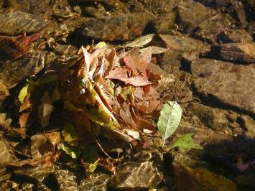
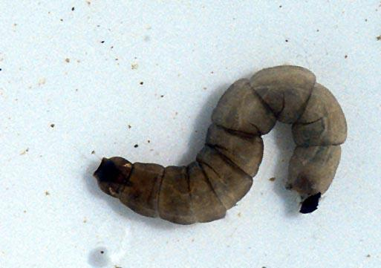
Where Aquatic Insects Live
Microhabitat- Leaf Packs
Explore more:
Review the "Artificial Leaf Packs" activity
from the module
http://www.stroudcenter.org/about/index.shtm
Cranefly larva
http://www.marietta.edu/~biol/biomes/wetlands.htm
Illustration Source: Aquatic Entomology by W. Patrick McCafferty, 1998
Notes:
In certain spots in a creek, leaves and other organic debris will gather up in clumps. These collections of leaves are another microhabitat preferred by some aquatic insects, like cranefly larva and small stonefly nymphs. We will discuss these leaves more a little later.

Slide 20
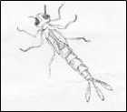
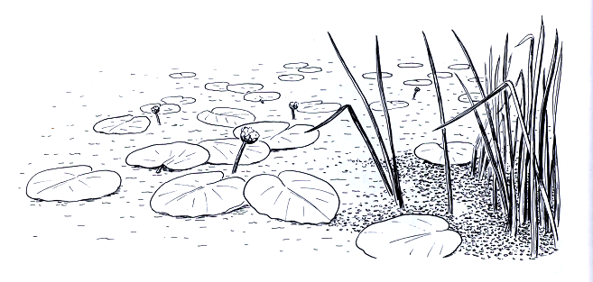
Where Aquatic Insects Live
Microhabitat-Plants
Macrophytes
Algae
Illustration Source: Aquatic Entomology by W. Patrick McCafferty, 1998
Notes:
Large aquatic plants, referred to as macrophytes, include grasses, lilies, rushes, milfoil, and elodea. These plants can be underwater, floating, or emerging out of the water, and all can be another place for aquatic insects to live. Beetles, damselfly and dragonfly nymphs love aquatic weeds. In addition, a smaller plant – called algae – that covers rocks can also be appealing to other aquatic insects.

Slide 21
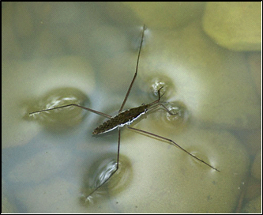
Where Aquatic Insects Live
Micro habitat - On the surface
What is the above insect called?
http://www.biosurvey.ou.edu/okwild/misc/waterstrider.html
http://faunanet.gov.au/wos/factfile.cfm?Fact_ID=161
Explore more:
• Do the “Life at the Surface” Activity from module.
Illustration Source: Aquatic Entomology by W. Patrick McCafferty, 1998
Notes:
Some bugs are too much on the move to like just one spot to live. Many water beetles and some water bugs spend most of the time swimming through the water or living on top of the water. QUESTION: Does anyone know what creature this is? ANSWER: A water strider. Other photo: Whiriligig beetle.

Slide 22
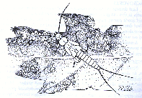
Aquatic Insect Feeding
Detritus
Decomposers
Coarse Particulate Organic Matter (CPOM)
Cranefly Larva
http://fenwick.pvt.k12.il.us/Creek/webpage/experimt/inverts/bugnumbr.html
Illustration Source: Stream Ecology: Structure and Function of Running Waters by J. David Allan, 1995
Notes:
Where aquatic insects live is sometimes dictated by the food that they need. In a stream, dead leaves, plant parts, twigs, and other organic matter is considered to be detritus. The detritus will begin to be broken down by bacteria and aquatic fungi, known as decomposers. Upon breakdown, the bacteria start producing useful nutrients to plants and to other stream organisms. This breakdown is also supplemented by certain aquatic insects called shredders. These insects include cranefly larvae, case-building caddisfly larvae, scuds, aquatic sowbugs, and some small stonefly nymphs. Shredders help to breakdown the clumps of organic materials, also referred to as coarse particulate organic matter (CPOM).

Slide 23
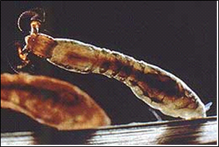
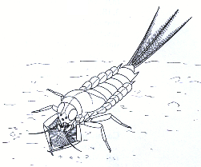
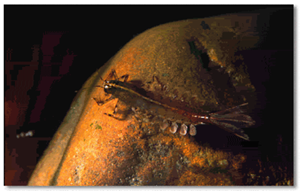
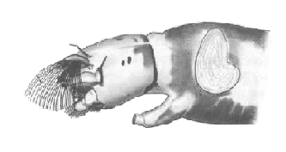
Aquatic Insect Feeding
Fine Particulate Organic Matter
(FPOM)
Filtering Collectors
Gathering Collectors
Brushlegged Mayfly Nymph
Blackfly Larva
Illustrations Source (both): Aquatic Entomology by W. Patrick McCafferty, 1998
Notes:
The broken down CPOM becomes fine particulate organic matter (FPOM) and becomes food for another type of aquatic insect called collectors. These collectors can be filtering collectors that obtain food from bits and pieces in the water column. Filtering collectors include some mayfly nymphs, net-spinner caddisfly larvae, blackfly larvae, mussels, and some midge larvae. Gathering collectors get their food from the stream bottom and include some mayfly nymphs, some caddisfly larvae, and some midge larvae.

Slide 24
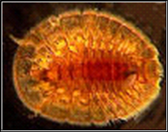
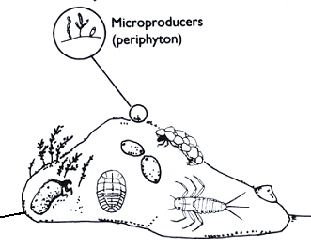
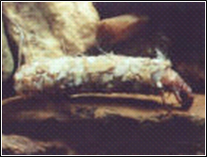
Aquatic Insect Feeding
Periphyton - algae on rocks
Water Penny
http://www.vvm.com/~jevans/sfaquaticinvertebrates/folderaquaticinsects/wpenn.html
Case-building Caddisfly Larva
www.rollanet.org/~streams/ macroinv/caddiscase.jpg
Illustration Source: Stream Ecology: Structure and Function of Running Waters by J. David Allan, 1995.
Notes:
The breakdown of organic matter produces nutrients that can be used by algae and other plants in the water. Periphyton is algae that grows on rocks on the substrate. The macroinvertebrates that dine on periphyton are called grazers or scrapers. Among these are water pennies, flathead mayfly nymphs, snails, and casebuilding caddisfly larvae.

Slide 25
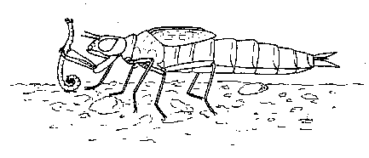
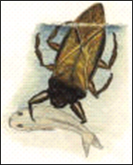
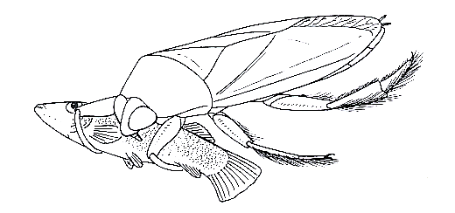
Aquatic Insect Feeding
Dragonfly Larva
Giant Water Bug
http://bruinbooks.com/giantwaterbug.htm
Giant Water Bug
Illustrations Source (two above): Aquatic Entomology by W. Patrick McCafferty, 1998
Notes:
All of these insects are food for predatory aquatic insects. Some predators include: dobsonfly larvae, fishfly larvae, dragonfly nymphs, water bugs, most beetles, crayfish, water striders, and some larger stonefly nymphs. Often predators have body parts that show they like to eat meat - strong mouthparts, modified grasping appendages, piercing and sucking mouthparts, or a large overall size.

Slide 26
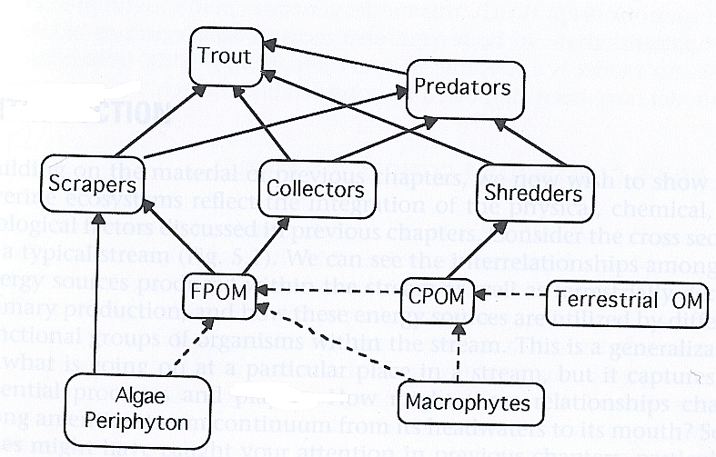
Aquatic Insect Feeding
Aquatic Food Web
Notes:
All of these eating creatures fit together into an aquatic food web that includes the leaves that fall into the creek, other plants like weeds and algae, all of which are broken down and used by insects including the shredders, collectors, and scrapers. All of which become food sources for predators, whether a fishfly larva insect or a hungry trout. All of these types of feeding groups are needed in a stream ecosystem.

Slide 27
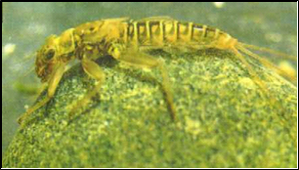
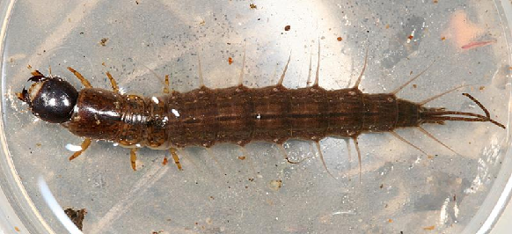
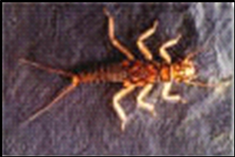
Aquatic Insect Movement
Cling to rocks
Mayfly nymph http://www.wwf.org.nz/earthsaver/es_18.cfm
Fishfly Larva
http://www.pbase.com/tmurray74/image/59792311
Water Penny
http://www.vvm.com/~jevans/sfaquaticinvertebrates/folderaquaticinsects/wpenn.html
Stonefly Nymph
http://www.fishing-in-wales.com/wildlife/insects/stonefly/
Notes:
In order to eat, aquatic macroinvertebrates must be able to move around. These creatures can be classified into groups by their means of locomotion.
Clingers are aquatic macroinvertebrates that grasp onto rocks in flowing water. To successfully do this and to keep from getting washed downstream, aquatic insects have different strategies and body adaptations to help. The water penny has a suction cup-like body to help stay attached to a rock. A mayfly nymph’s body is as flat as possible, to allow water to flow overtop easier. Riffle beetles and dobsonfly larvae use strength and strong claws to grasp rock crevices. There are many other clingers.

Slide 28
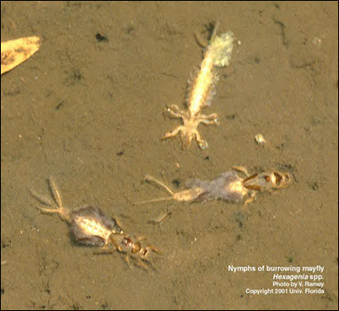
Aquatic Insect Movement
Burrow in soft, sandy, silty bottoms found in pools or under rocks.
Burrowing Mayfly Nymphs
http://aquat1.ifas.ufl.edu/gallery4.html
http://sherpaguides.com/georgia/flint_river/wildnotes/
Notes:
Burrowers tend to live in the softer, sandy bottoms of the stream either in slower pool areas or underneath larger rocks in the riffles. Burrowers will bury themselves under the surface to keep out of the stream flow and keep from predators. The best example is a burrower mayfly nymph, which even has broad front legs and shovel like hard tusks to help it dig. Midge larvae are another widespread burrower that you might find.

Slide 29
Aquatic Insect Movement
Move around on top of, below, or between rocks.
Dragonfly Larva and Case-Building Caddisfly
http://www.thomasames.com/insects/other/
www.rollanet.org/~streams/ macroinv/caddiscase.jpg
Illustration Source: Aquatic Entomology by W. Patrick McCafferty, 1998
Notes:
Sprawlers crawl about freely in still or slightly moving waters, often residing on the underside of rocks or in between rocks of the substrate. QUESTION: Can you guess why sprawlers are not usually found in fast riffles? ANSWER: They would get washed away. Sprawlers include casebuilding caddisfly larvae and some dragonfly larvae.

Slide 30
Aquatic Insect Movement
Climb on vegetation - macrophytes & algal mats.
Damselfly Larva
http://www.kendall-bioresearch.co.uk/odonata.htm
Dragonfly Larva
http://www.ento.csiro.au/Ecowatch/Primary/insects/pages/dragonfly_nymph.htm
Notes:
Climbers will be found in heavily vegetated areas of a waterway, where there are plenty of macrophytes and algal mats. Climbing on plant stems, roots, and leaves, a damselfly and dragonfly nymph are examples of climbers. They use their long legs and clawed feet to effectively climb.

Slide 31
Aquatic Insect Movement
Swim through the water - from bottom to top.
Diving Beetle
Illustrations Source: Aquatic Entomology by W. Patrick McCafferty, 1998
Notes:
Swimmers are on the move. Bodies of water beetles and some water bugs have adapted to efficiently swim underwater. They have streamlined bodies to pierce through the water and their appendages are specialized for swimming. These appendages are often oar-like and contain swimming hairs, which increases the surface area of the leg to paddle better through the water.

Slide 32
Aquatic Insect Movement
Float right below water surface.
Mosquito larva
http://www.backyardnature.net/yucatan/wiggtail.htm
Water scorpion
http://www.szgdocent.org/ff/f-wtrbg2.htm
Notes:
Floaters are usually only found in very slow stretches of streams or in ponds and lakes. They live at or near the water surface for respiratory purposes. They can have certain organs to increase buoyancy or use air bubbles to help them rise to and stay at the surface. A mosquito larva has a respiratory horn that it “snorkels” above the water surface.

Slide 33
Aquatic Insect Movement
Skate on the water surface.
Whirligig Beetle
http://www.szgdocent.org/ff/f-wtrbg3.htm
Water Strider
http://www.biosurvey.ou.edu/okwild/misc/waterstrider.html
Notes:
Lastly, skaters are on top of it all. Water striders and whirligig beetles skate upon the surface of the water, usually only in calmer stretches or in ponds and lakes. To help stay on top, skaters rely on surface tension (a physical property of water) and use skinny, elongated appendages to help balance their body weight.

Slide 34
Aquatic Insect Movement
Drift
· Escape pollution
· Escape lowering of water
· Find better food resources
· Escape predators
· Avoid overcrowding
· Find a better spot
Explore more:
• Do the “Create an Aquatic Macroinvertebrate” Activity from module.
Notes:
There is one other type of movement that can be used by all types aquatic macroinvertebrates. This is called drift. Insects let themselves get caught in the water flow and are carried downstream by the current usually for just a short distance (a few meters). Insects may choose to drift for a number of reasons: to escape a catastrophic event like pollution or the severe lowering of water, to find better food sources, to escape an increase in predator presence, to avoid overcrowding, or simply to just move downstream to find an even better spot.

Slide 35
River Continuum Concept
Describes and compares the gradual changes in a stream system from headwaters (start) to mid-order creek to mouth.
Shows how the insect feeding habits and movement differ as you go downstream from small stream to big creek or river.
Notes:
Now that we have discussed what aquatic insects eat, and how they move around, and how they breathe, these things are important factors to consider when finding a suitable place for an insect to live. A stream must provide habitat, food, and the conditions for the insect to survive. One attempt to predict what macroinvertebrates will live in different types of streams is called the River Continuum Concept. The concept describes and compares the gradual changes in a stream system from headwaters (start) to mid-order stream to mouth. Insect feeding habits and movement will be different in a headwaters stream than at the mouth of the same creek.

Slide 36
River Continuum Concept
Headwaters
Cranefly Larva
Stonefly Nymph
http://www.epa.state.oh.us/dsw/wqs/headwaters/
Notes:
A small, headwater stream is usually shaded by trees, limiting plant and algal growth. But there is plenty of coarse particulate organic matter (leaves, sticks, and plant parts from shore). So here, shredders (leaf eaters) are abundant. As the shredders create fine particulate organic matter (FPOM), then collectors can feast as well. Predators are present too.

Slide 37
River Continuum Concept
Headwaters
Mayfly nymph http://www.wwf.org.nz/earthsaver/es_18.cfm
Notes:
A flowing headwater stream usually has a rocky substrate. QUESTION: Any guess on what type of insect movement dominate here? ANSWER: Clingers (to rocks) and sprawlers (on the rocky, gravelly bottom) dominate the upper stretches of streams.

Slide 38
River Continuum Concept
Mid-order
South Branch of French Creek
Illustration Source (all): Stream Ecology: Structure and Function of Running Waters by J. David Allan, 1995.
Photos source: Creek Connections
Notes:
A mid-order creek changes the feeding habits and movement capabilities. Since mid-order streams are wider and more open, sunlight allows more plants and periphyton (algae on rocks) to grow. Therefore more grazers /scrapers can survive here, dining on the periphyton. There is also FPOM available, having floated downstream from the headwaters or from messy grazers/scrapers shredding up their periphyton. With FPOM, there will be more collectors. A few shredders might be found because there is still some clumps of leaves to eat. Predators are present too.

Slide 39
River Continuum Concept
Mid-order
Illustration Source: Stream Ecology: Structure and Function of Running Waters by J. David Allan, 1995.
Notes:
Movement in the mid-order stream is varied because the substrate is varied. Fast riffles with rocky bottoms can yield to slower stretches with sandy muddy bottoms. So you might find just about any type of insect movement because of all the habitat and stream condition variety. Clingers, burrowers, sprawlers, climbers, swimmers, floaters, skaters.

Slide 40
River Continuum Concept
Mouth
Confluence of Kiski and Allegheny River
http://www.panoramio.com/photo/28680516
Notes:
At the mouth of a large creek or river, life is very different aquatic organisms. Wide water gets plenty of sunlight, but primary productivity (plants) is often limited by water cloudiness, so not as many grazer/scrapers are found. The prevalent group are collectors because of all the fine particulate organic matter that has floated downstream to this spot. Predators are also present.

Slide 41
River Continuum Concept
Mouth
Water Strider
Notes:
Movement at the mouth is dictated by the fact that the waterway bottom is much more muddy, silty, and sandy with maybe small gravel and only a few large rocks. These conditions are perfect for burrowers, and less optimal for clingers and sprawlers. The mouth is also usually much slower so skaters and floaters can find satisfactory conditions.

Slide 42
River Continuum Concept
Focuses on:
Food Conditions
Habitat Conditions
Explore More:
•http://www.cotf.edu/ete/modules/waterq/
wqcontinuum.html
Headwaters
Mid-Order
Mouth
Notes:
The river continuum concept is important to consider when studying the biology of a waterway. Sometimes, no matter how hard you try, you won’t find certain aquatic insects present because the food and habitat conditions are not right for them. There are natural differences between upstream and downstream, small creeks and large rivers.

Slide 43
Insects Reveal Stream Health
Woodcock Creek
Indian Run
http://www.stroudcenter.org/research/projects/Streamwatch/sites/east_branch/site18.shtm
Notes:
But what if you are studying a mid-order stream, expecting to find a lot of aquatic macroinvertebrates and you don’t find any. Then something else must be happening that is affecting the habitat, food availability, or that is deteriorating the water conditions (amounts of oxygen, temperature, flow rate, nutrient levels, etc.). The aquatic insects found or the lack of aquatic insects found can help determine if conditions are appropriate in the stream. The aquatic life found can help determine if a stream is healthy or unhealthy or polluted.

Slide 44
Insects Reveal Stream Health
Chemical Testing vs. Biological Testing
Aquatic Insects are Indicator Organisms
They will show if there have been negative changes in water quality or habitat conditions.
Notes:
Many stream scientists and water quality experts turn to biological monitoring to help determine stream health. Unlike chemical testing that is a brief snapshot of water quality, collecting aquatic organisms that have been in contact with the water all the time can often reveal a more accurate story of what is going on with stream health. The main reason is that aquatic insects are indicator organisms, creatures that are sensitive to changes in water quality and will react to those changes in predictable ways.

Slide 45
Insects Reveal Stream Health
Pollution-Sensitive Group I Organisms
Illustrations sources: Monitor’s Guide to Aquatic Macroinvertebrates, Save Our Streams – Izaak Walton League of America, 1994 and Aquatic Entomology by W. Patrick McCafferty, 1998
Notes:
All aquatic macroinvertebrates do not have the same level of tolerance to water pollution. Through much study and research, it has been determined that some aquatic insects can only survive in clean water with enough oxygen, the right temperature, limited sedimentation, and appropriate habitat. These insects are classified as pollution-sensitive (group 1 organisms). Examples include mayflies, stoneflies, water pennies, dobsonfly, case-building caddisfly, and riffle beetles.

Slide 46
Insects Reveal Stream Health
Facultative Group II Organisms
Illustrations sources: Monitor’s Guide to Aquatic Macroinvertebrates, Save Our Streams – Izaak Walton League of America, 1994 and Aquatic Entomology by W. Patrick McCafferty, 1998
Notes:
Some insects are in the facultative group, or somewhat sensitive group (group 2). They can tolerate some pollution and disturbance and can tolerate a wider range of water quality conditions as compared to the pollution-sensitive bugs. Some example of these aquatic macroinvertebrates include a cranefly larva, fishfly, scud, net-spinning caddisfly larva, beetle larva, and crayfish.

Slide 47
Insects Reveal Stream Health
Pollution Tolerant
Group III Organisms
Illustrations sources: Monitor’s Guide to Aquatic Macroinvertebrates, Save Our Streams – Izaak Walton League of America, 1994 and Aquatic Entomology by W. Patrick McCafferty, 1998
Notes:
Pollution-tolerant insects (group 3) can survive in pollution and poor water quality conditions. These can include blackfly larva, midge larva, leeches, aquatic worms, and some snails.

Slide 48
Insects Reveal Stream Health
Biodiversity= lots of different types of life
http://expertprojectaces.wikispaces.com/Macroinvertebrate+Introduction
http://www.fly-fishing-discounters.com/brook-trout.html
Notes:
If a stream is healthy, it will have good biodiversity in it – lots of different types of life, from algae to bugs to fish to bacteria. A healthy stream will also have diversity in the aquatic bugs that are found. There should be lots of different types of bugs from all three pollution tolerance groups (1, 2, and 3).

Slide 49
Insects Reveal Stream Health
Biodiversity= Healthy Stream
This is Good biodiversity!
Notes:
So if you find a leech in the water, which is a pollution tolerant creature, it does not necessarily mean that the waterway is polluted. If the leech is found along with lots of other types of aquatic bugs from the pollution sensitive group and the facultative group, then that means there is good biodiversity in the stream, which means the waterway is probably healthy.

Slide 50
Insects Reveal Stream Health
Biodiversity= Healthy Stream
This is Poor biodiversity.
Notes:
However if all you find in the waterway is a leech and maybe a few midge larva (all pollution tolerant), and no other types of bugs, then something might be wrong with the waterway making it unhealthy. This is an example of poor biodiversity and with only pollution-tolerant bugs.

Slide 51
Insects Reveal Stream Health
Biodiversity= Healthy Stream
Is the diversity of this stream good or poor?
Notes:
What if you found only 10 mayfly nymphs, 5 stonefly nymphs, and 2 dobsonfly larva? QUESTION: What would you conclude about this stream? Think carefully.
< Click if doing PowerPoint Presentation>

Slide 52
Insects Reveal Stream Health
This is still Poor biodiversity.
Notes:
ANSWER: Even though these are pollution-sensitive creatures that can only survive in clean water, this is not a very biodiverse collection of critters. If a stream is really healthy, there should be more variety and more numbers. It might be worth investigating the stream more, conducting additional tests, and improving your insect collection techniques

Slide 53
Insects Reveal Stream Health
Notes:
Scientists have developed structured methods to collect and summarize aquatic macronivertebrate data and to score the results to determine if a stream is healthy or unhealthy. There are many versions of these biosurveys, often referred to as pollution tolerance indexes. They all attempt to use the type of aquatic insects, their pollution sensitivity level, and the number of aquatic insects to determine a stream score.

Slide 54
Insects Reveal Stream Health
Notes:
For most surveys, a high score means there was diversity in insects with pollution sensitive creatures definitely being present. A high score means healthy stream. A low score is usually indicative to catching only a few kinds of organisms or catching only pollution tolerant bugs. A low score reflects a polluted or disturbed waterway.

Slide 55
Collecting Aquatic Insects
Qualitative Sampling Quantitative Sampling
Explore more:
- EPA: Match the Hatch slide show movie - http://www.epa.gov/OWOW/NPS/kids/MOVIE.HTM
- http://www.kidfish.bc.ca/insects.htm
- Do the “Aquatic Insect Life Cycle” Activity from module.
Photos source: Creek Connections
Notes:
Before you can count the aquatic macroinvertebrates and score them, you have to collect them first. There are many different ways to collect macroinvertebrates. They usually fall into two categories – qualitative sampling methods and quantitative sampling methods.

Slide 56
Collecting Aquatic Insects
Qualitative Sampling
· Less scientific approach.
· Less strict methods.
· More concerned with observations
of all aquatic organisms.
· What kinds of life is there instead
of how much is there.
· Provide overall, general data.
Photo source: Creek Connections
Notes:
A qualitative study is less strict, less scientific in the approach, and is more concerned with visual observations and discovering all of the organisms within the stream area, thus providing some overall data. It does not require that measurements and records are made of how many or how much of something is present. The qualitative study simply asks what was observed. And it doesn’t really matter how the observations are made; procedures can vary and be less technical because they do not have to be specifically repeated in the future.

Slide 57
Collecting Aquatic Insects
Quantitative Sampling
· Measure data, not just observe.
· Record the amount and type of aquatic life present.
· Specific and repeatable scientific methods.
· Better for comparing data and repeating research in the future or at a different site.
Photo source: Creek Connections
Notes:
A quantitative study requires that data are measure, not simply observed. The amount, number, size, shape, and degree of various factors must be measured and recorded. For example, a quantitative stream macroinvertebrate study would require recording the amount and type of aquatic life present. Quantitative studies are also much more concerned about specific scientific procedures in collecting data, procedures that could possibly be repeated in the future to compare data. This would include having a fixed amount of area being studied, for example 3 square meters. The numerical data of quantitative samples can be compared among different sites and can also provide better results for professional stream evaluations.

Slide 58
Collecting Aquatic Insects
Equipment
D-frame net
Kick net
Surber Sampler
Drift net Artificial Substrate Sampler
Illustrations Source (all): Aquatic Entomology by W. Patrick McCafferty, 1998
Notes:
There are many different ways to collect aquatic macroinverteberates. Kick nets and d-frame nets are the most common collection equipment, but other nets include drift nets and surber samplers. Another way to collect aquatic insects is to use artificial substrate samplers, such as multi-plate samplers (Hester Dendys), artificial leaf pack bags, or wire baskets of rocks.

Slide 59
Collecting Aquatic Insects
Equipment / Method
Illustrations Source (above): Aquatic Entomology by W. Patrick McCafferty, 1998
Used to conduct quantitative studies and for filling out pollution tolerance indexes.
Notes:
If used with a structured, repeatable method and if studying a specific amount of stream area (ie. 3 square meters or 5 transects of 2 meters), all of this equipment can be used to conduct a quantitative study. Quantitative studies are more useful if you are going to use a pollution tolerance index to determine stream health.

Slide 60
Identifying Aquatic Insects
Dichotomous key
Source of key:
Save our Streams Program of Izaak Walton League of America http://www.iwla.org/sos/
Photos source: Creek Connections
Illustrations Source (above): Aquatic Entomology by W. Patrick McCafferty, 1998
http://www.people.virginia.edu/~sos-iwla/Stream-Study/Key/MacroKeyIntro.HTML
Notes:
After collecting aquatic insects, you will need to identify them. There are many resources available to do so, ranging from simple illustration pages to provide a general name to very detailed dichotomous keys to identify insects more specifically. A dichotomous key uses a system of choices made of the observed specimen’s body to determine its identity.

Slide 61
Enjoying Aquatic Insects
Photos source: Creek Connections
Explore more:
•http://macroinvertebrates.org/#/
•http://www.stroudcenter.org/education/MacroKeyPage1.shtm
•http://www.dcnr.state.pa.us/stateparks/watersheded/studying/biological/index.htm
http://www.cerc.usgs.gov/Branches.aspx?BranchId=41
Notes:
Equipped with your nets, dichotomous keys, and knowledge about the different types of aquatic insects and their needs, you are bound to discover some fascinating aquatic creatures and have fun learning about your waterways. Enjoy.

